Slide 1

Python Course Chapter 0
Introduction to Python

Slide 2
Introuduction to Python
What’s Python?
Why learning Python?
What are the disadvantages of Python?
How to download Python?
What’s in this course?

Slide 3


What’s Python?
Python is an interpreted high-level, general-purpose programming language. (it’s okay if you don’t know what that means, you just need to know it’s a programming language.)
Guido van Rossum began working on Python in the late 1980s, and its design philosophy emphasizes code readability with its use of significant indentation.
Python 2 was discontinued with version 2.7.18 in 2020. In this course, we will be learning Python 3.

Slide 4
What’s Python?
Since most modern OS are written in C, compilers/interpreters for modern high-level languages are also written in C. Python is not an exception - its most popular/"traditional" implementation is called CPython and is written in C.
Most of the standard library that comes along with Python is written in Python itself, other parts written in C or making use of C libraries internally.

Slide 5
Why learning Python?
There are several advantages of using Python.
Python is easy to learn. For example, to write the same program that does 10 + 5, Python only needs at most 4 lines of code, whereas Java or C needs a lot more lines. (See the Python Java comparison example.)
Python is expressive. By saying expressive, it means that we can use a few lines of code to express something we want to achieve. For example, to exchange values of 2 variables, the difference between Python and other languages will be:

Slide 6
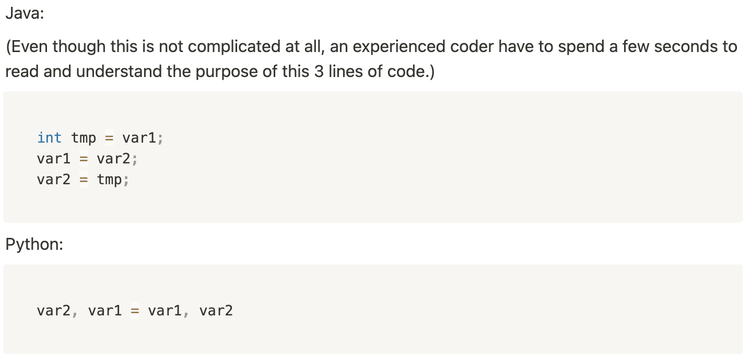
Why learning Python?

Slide 7
Why learning Python?
Python is readable. Programming languages are not only for computers. If a programming language is readable for humans, it would be easier to debug (for others) and maintain (for you).
Python has a huge built-in functionality library. If you were trying to send emails, build websites, use a database, use operating systems, send HTTP requests, make GUI (graphical user interface), you can use some codes that other people already wrote for you of writing it from scratch.
Python is a cross-platform language, which means it can run on Windows, UNIX, Linux, and Mac.

Slide 8
Why learning Python?
Python is open-source, which means you can modify it if you want to. If you are interested in how it works, you may also read the source code of Python to figure it out.
Python is widely used. It’s used in financial analysis, machine learning, deep learning, statistics, Keras, TensorFlow, etc. Before entering the field of Artificial Intelligence, it’s necessary to know Python in advance.

Slide 9
Disadvantages of Python
Python is slower (compared to compiled languages). Compiled languages, such as C, get compiled to machine codes (something CPU can read and execute). Since Python is not a compiled language, its execution speed is not as fast as C or other compiled languages.
Python is a relatively new language; therefore, its built-in library is not as huge as C or Java. (However, the Python library is good enough already.)
Python doesn’t have too much support for mobile devices. For example, Python is not what you want to use if you develop a commercial mobile app.

Slide 10
How to Download Python?
You are welcome to download python from https://www.python.org. However, it would be better to use Anaconda tools. (Windows users might need to download it from the Windows store.) (MacOS users might have Python pre-installed in OS already. Use the terminal to check the current python version.)
Go to https://www.anaconda.com and download the whole development package.

Slide 11
What’s in this course?
Python Data Types
Python Operators, Control Flow, and Pythonic Syntax
I/O with Files
Object-Oriented Programming
Modules and Packages
Error Handling
Useful Modules, such as os, math, regular expression, and so on.
Web Scraping
Database, Emails
Images, Flask, and Tkinter

Slide 12

How to take notes
There are many ways to take notes; however, I recommend using free cross-platform software, Notion. First, go to:
https://www.notion.so/desktop
And download Notion according to the OS. (We can also download Notion on Android or iOS devices.)
Notion supports both markdown and latex syntax. Besides, we can use Notion to store codes of many different programming languages.

